Slide 1


Business Data Analysis
课程目的：拿OFFER
简历
学习
简历
面试

Slide 2

面试英语---反客为主
客场劣势
面试官是强势
陌生的场景陌生的人
英语劣势
母语不是英语
心理劣势
焦虑和紧张
面试官控制面试会发生什么？
怎么反客为主，弱势变强势从而掌控面试走向？

Slide 3
学习的目的-准备简历和面试
Transform interview into a presentation whenever possible
把面试变成一个演讲简报

Slide 4
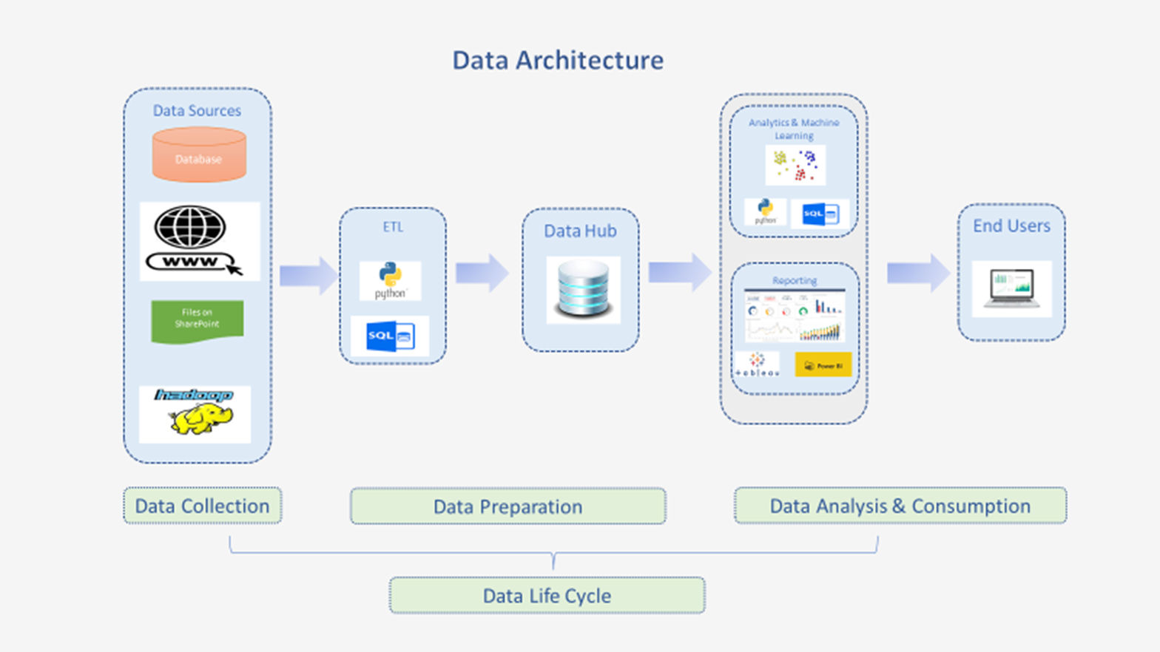
数据架构
http://localhost:8888/notebooks/Business_Data_Analysis/Jupyter%20Notebook/Environment_setup.ipynb

Slide 5
面试英语---反客为主
Business process/业务流程
Identify/understand business goals/problems/opportunities
Project process/项目流程
Identify & meet with stakeholders
Data process/数据流程
Data collection
Data preparation
Data Analysis
Data visualization/reporting
Data productization
Present solution/story telling
Set & prioritize goals
Collect business requirements
Define deliverables
Create project schedule
Identify risk /potential roadblocks
Testing
Review documents and interview SME(Subject Matter Expert)
Convert business problems to metrics. Discuss metrics with stakeholders
Propose data solutions to the problems/opportunities identified.

Slide 6
面试英语---反客为主
Business process/业务流程
Identify/understand business goals/problems/opportunities
Review documents and interview SME(Subject Matter Expert)
Convert business problems to metrics. Discuss metrics with stakeholders
Propose data solutions to the problems/opportunities identified
Identify & meet with stakeholders
Set & prioritize goals
Collect business requirements
Define deliverables
Create project schedule
Identify risk /potential roadblocks
Data collection
Data preparation
Data Analysis
Data visualization/reporting
Data productization
Testing
Present solution/story telling
Project process/项目流程
Data process/数据流程

Slide 7
Business Data analysis/商业数据分析
MARKETING/市场营销部门项目
Type of Marketing Campaigns/市场营销活动的主要种类
Product Marketing Campaign/产品营销活动
Acquisition Marketing Campaign/客户获得
Customer retention Campaign/客户挽留
Budget/预算: Not all marketing campaigns require an incremental budget, but many still do. Factor in the agency, advertising, and freelance costs, if appropriate, and factor these numbers into any ROI analysis/投资回报分析 for your campaign.

Slide 8
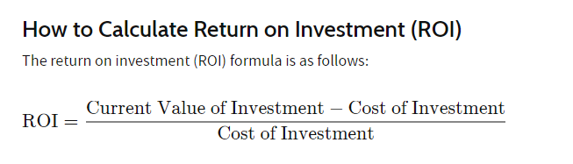
Business Data analysis /商业数据分析
MARKETING/市场营销部门项目
怎么算促销活动的回报？

Slide 9
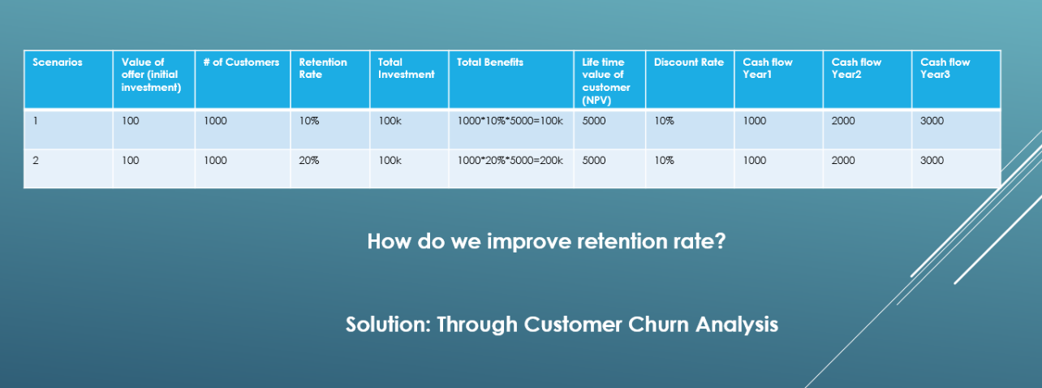
Business Data analysis /商业数据分析
ROI Financial analysis
随机
非随机

Slide 10
Business Data analysis /商业数据分析
Churn analysis/客户流失分析
Churn analysis is a review of a bank’s customers data that reveals their composition and trends. It looks for correlations between customers who became inactive during a period of time and variables such as tenure, product holding, service calls, seasonality, and demographics.
客户流失分析是分析客户组成和趋势的数据。寻找客户的特征比如时间长度，持有什么产品，打过服务电话，季节性，人口成分等与客户流失的关联。

Slide 11
Business Data analysis /商业数据分析
Churn analysis/客户流失分析---data 数据
CustomerId | CreditScore | Geography | Gender | Age | Tenure | Balance | NumOfProducts | HasCrCard | IsActiveMember | EstimatedSalary | Churn
15592531 | 822 | France | Male | 50 | 7 | 0 | 2 | 1 | 1 | 10062.8 | yes
15577657 | 732 | France | Male | 41 | 8 | 0 | 2 | 1 | 1 | 170886.17 | Yes
15614049 | 664 | France | Male | 55 | 8 | 0 | 2 | 1 | 1 | 139161.64 | yes
15640635 | 769 | France | Male | 29 | 8 | 0 | 2 | 1 | 1 | 172290.61 | yes
15724944 | 663 | France | Male | 34 | 7 | 0 | 2 | 1 | 1 | 180427.24 | yes
15625524 | 512 | France | Male | 40 | 5 | 0 | 2 | 1 | 1 | 146457.83 | No
15789669 | 510 | France | Male | 65 | 2 | 0 | 2 | 1 | 1 | 48071.61 | No
15810845 | 636 | France | Male | 42 | 2 | 0 | 2 | 1 | 1 | 55470.78 | No
15656176 | 501 | France | Male | 57 | 10 | 0 | 2 | 1 | 1 | 47847.19 | No
15624592 | 603 | France | Male | 31 | 8 | 0 | 2 | 1 | 1 | 169915.02 | No
15727829 | 567 | France | Male | 42 | 2 | 0 | 2 | 1 | 1 | 167984.61 | No
15636684 | 727 | France | Male | 34 | 10 | 0 | 2 | 1 | 1 | 198637.34 | yes
15653857 | 498 | France | Male | 34 | 2 | 0 | 2 | 1 | 1 | 148528.24 | yes
15668893 | 782 | France | Male | 39 | 8 | 0 | 2 | 1 | 1 | 33949.67 | yes
15785819 | 681 | France | Male | 38 | 3 | 0 | 2 | 1 | 1 | 112491.96 | yes
15811490 | 627 | France | Male | 33 | 5 | 0 | 2 | 1 | 1 | 103737.82 | yes
15576256 | 582 | France | Male | 39 | 5 | 0 | 2 | 1 | 1 | 129892.93 | yes
15676715 | 640 | France | Male | 68 | 9 | 0 | 2 | 1 | 1 | 199493.38 | yes
15642291 | 685 | France | Male | 23 | 8 | 0 | 2 | 1 | 1 | 112239.03 | yes

Slide 12
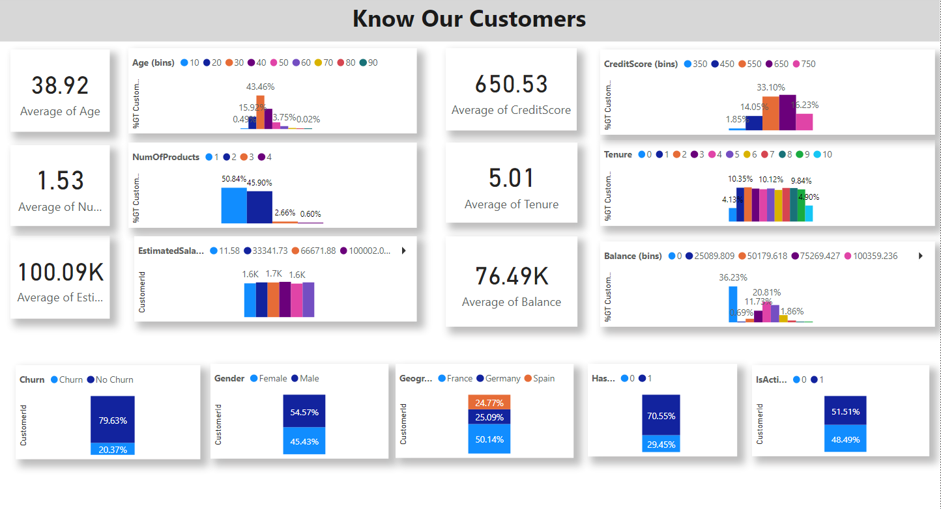
Summarize your data/总结你的数据
The power of visualization/视觉化的威力

Slide 13
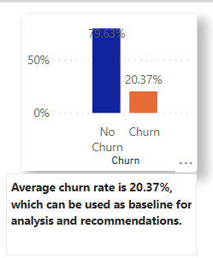
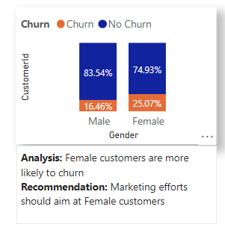
CHURN ANALYSIS
Baseline/基线

Slide 14
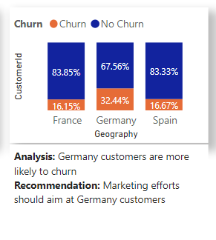
CHURN ANALYSIS
Baseline/基线

Slide 15
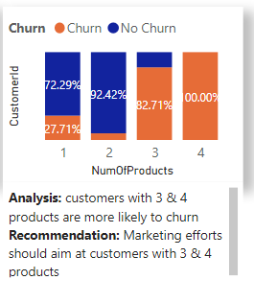
CHURN ANALYSIS
Baseline/基线

Slide 16
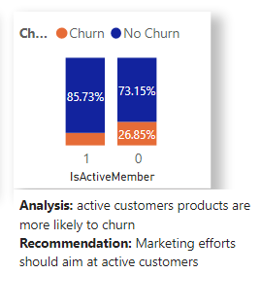
CHURN ANALYSIS
Baseline/基线

Slide 17
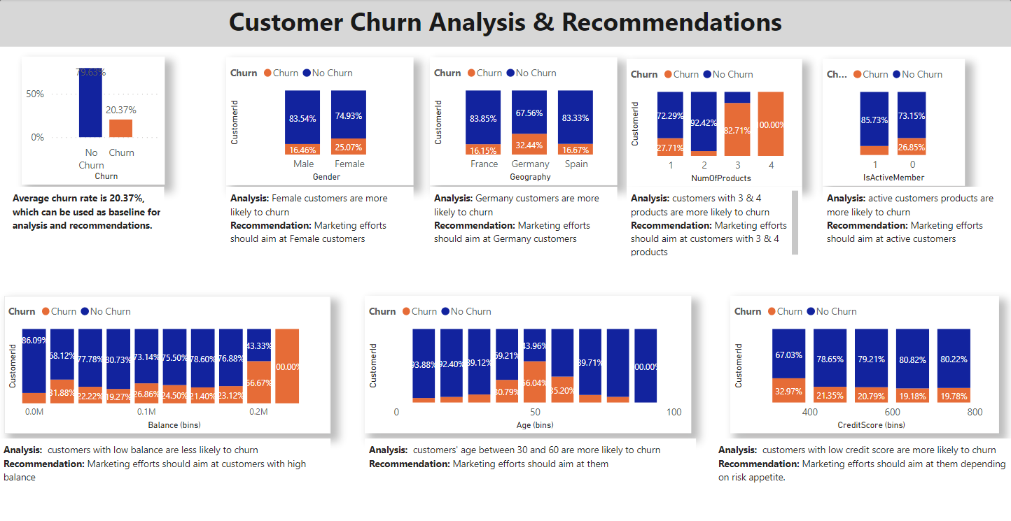
CHURN ANALYSIS

Slide 18
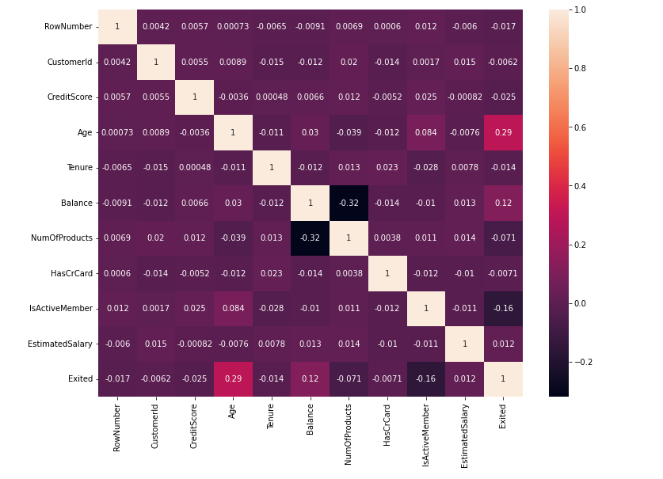
CHURN ANALYSIS--- correlation /关联

Slide 19
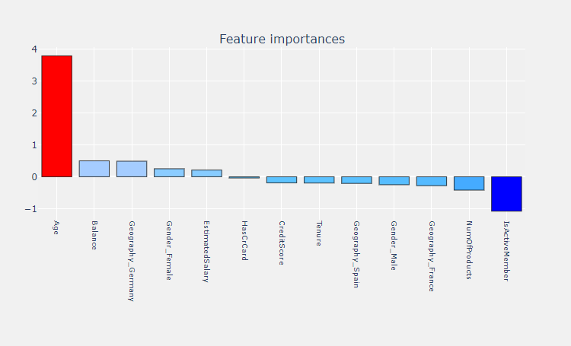
CHURN ANALYSIS---REGRESSION/回归

Slide 20
CHURN ANALYSIS---REGRESSION/回归
Churn/流失
CreditScore
Age
Quantify/量化
One to Many/一对多关系
Ranking/排序
Explain/解释
Control/控制
Predict/预测
Geography
Tenure
Gender
Balance
Regression Model 回归分析模型

Slide 21
面试英语---反客为主
面试官控制面试会发生什么？
怎么反客为主，弱势变强势从而掌控面试走向？
面试官不感兴趣怎么办？

Slide 22
数据类招聘启事分析
Analysis of Job Descriptions
Job #1
This position is an 18 month secondment. You’ll be part of a dynamic team that provides advanced analytics services to assist Business Controls with effective risk management./风险管理
Job #2
The primary purpose of this position is to support the financial planning, sales compensation/销售报酬 and business intelligence team on automation projects, data reconciliations, data blending, forecasting and data modelling. This is a highly dynamic role where you would be working on the key data elements of the BI team.
Job #3
Min 3 years of experience in a lending or financial institution with hands on experience in credit analytics信用分析.
Job #4
The Manager, HR Reporting & Insights人事报告 is responsible for managing the development, delivery and execution of HR insights by applying people data and analytics expertise to improve workforce decisions that drive business performance and growth. This role maintains relationships with multiple stakeholders from HR and the business, ensuring that HR data related projects (e.g. data hygiene, insights and analytics) are properly assessed and executed. This role also identifies opportunities to enhance the HR analytics capability of the Bank.

Slide 23
Business Data analysis/商业数据分析
Category of jobs /招聘数据分析的部门分类
Sales/销售
Marketing/营销
Internal Audit/Risk/风控
Credit/信用
HR/人事

Slide 24
项目课
项目内容---用Python, SQL,POWER BI, TABLEAU 来做项目
数据架构1个项目
怎么搭建数据架构
Sales 销售3个项目
销售业绩，
客户关系管理，
促销活动
Marketing 营销1个项目
客户流失分析
Internal Audit/Risk 风控3个项目
破产风险分析，
欺诈分析，
异常分析
Credit 信用1个项目
信用分析
HR 人事1个项目
雇员流失分析

Slide 25
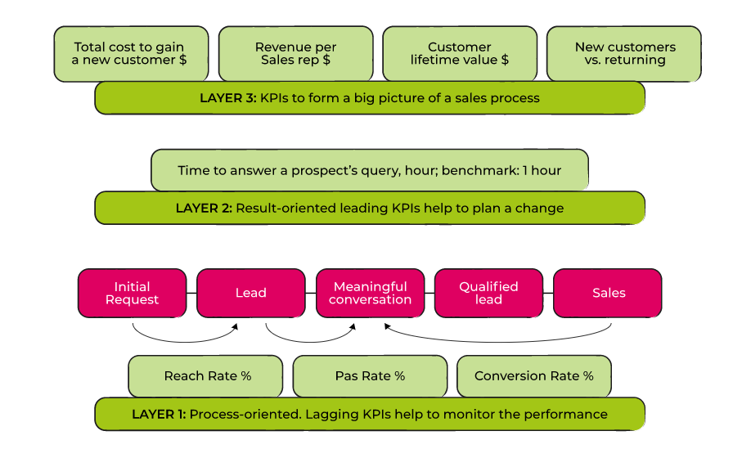
Business problems 1:Sales performance kpi 银行销售业务问题1：怎么提高销售业绩

Slide 26
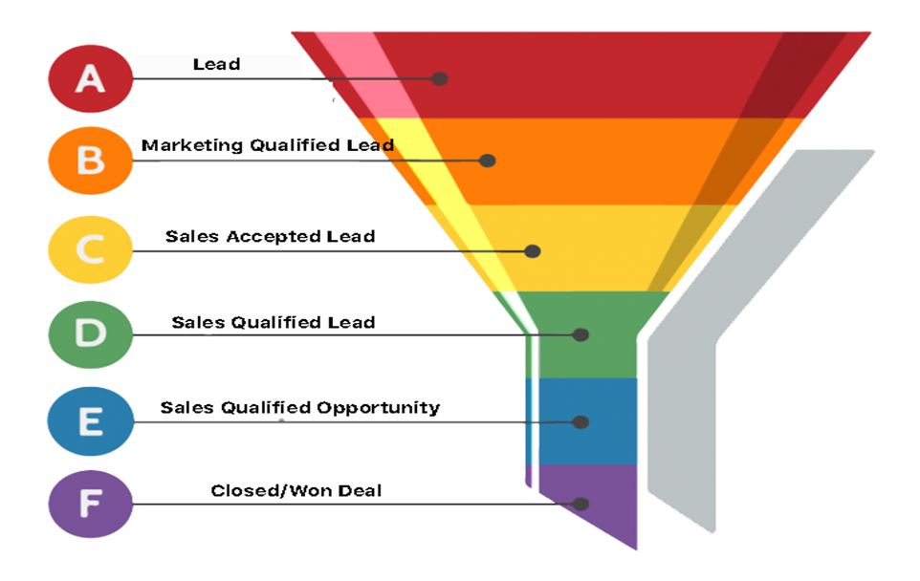
Sales conversion rate 销售人员客户转换率

Slide 27
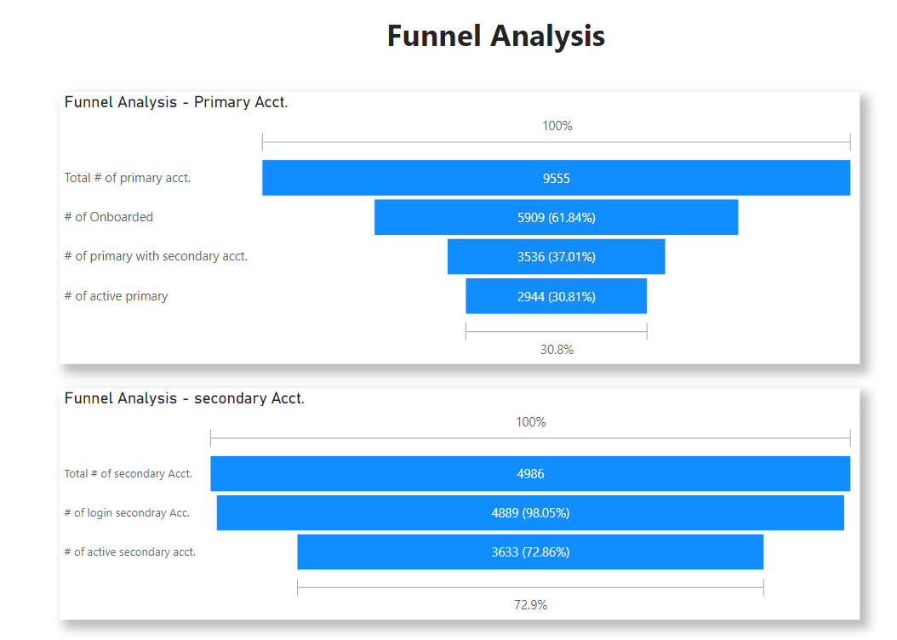
Funnel analysis 过滤分析
Analysis/分析: Primary onboard rate is around 62% and Primary with secondary accounts rate is around 37% and 31% of Primary actively using the product. Once secondary open accounts, their retention rate is much higher.
Recommendations/推荐: Compare the 31% retention rate with benchmark and direct marketing efforts accordingly.

Slide 28
Business problems 2: customer relationship 业务问题2：客户关系
The true success of sales is in building a customer relationship that spans for as long as possible. 销售业绩与客户关系的成功与否密切相关
That makes customer retention a high-priority goal. 留住客户是优先目标
Why should sales focus on customer retention as a metric for measuring sales success? 销售应该把留在客户作为一个标的来评测销售的成功与否
new customer acquisition is five times more costly when compared to the cost of retaining existing customers 获得新客户成本5倍高于留住一个老客户

Slide 29
Cohort analysis
A cohort is a group of users who share a common characteristic over a certain period of time. Cohort analysis is the study of the common characteristics of these users over a specific period.
一组有相同特征的在一段时间内的客户。Cohort是学习这些客户的特征
cohort analysis is commonly used to identify reasons why customers leave and what can be done to prevent them from leaving
Cohort 通常是用于找到客户为什么离开的原因
Acquisition Cohorts: This cohort divides users based on when they were acquired or signed up for a product. Depending on your product, user acquisition could be tracked daily, weekly, or monthly.
一种cohort 分析是按照开户时间来分析他们的行为

Slide 30
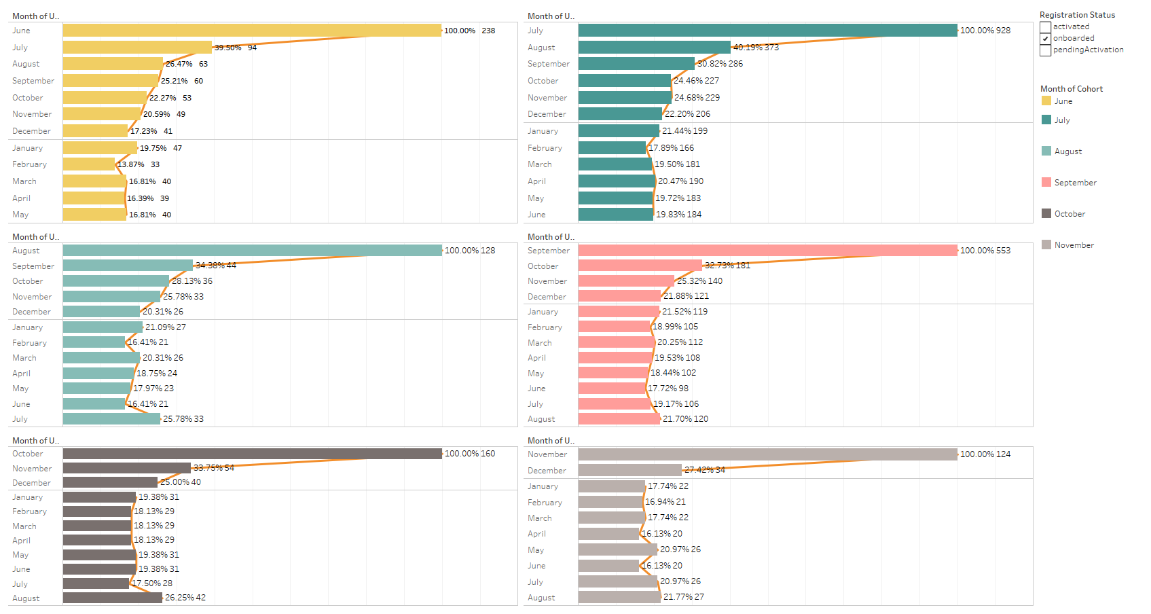
Cohort analysis
Assumptions: The Retention Rates were calculated based on “User Login Month”.
Analysis: The Retention Rates (Onboard June – Nov.) for primary accounts range from 16.8% to 26.3% . The rates tend to stabilize after 2-3 months.
Recommendations: time the marketing efforts based on the time window.

Slide 31
Business problems 3 :Marketing campaigns 业务问题3：怎么提高促销有效率
Marketing campaigns promote products through different types of media, such as television, radio, print, and online platforms.
促销活动通过不同的平台，比如电视，广播，网络，手机等平台
How to improve Marketing campaigns efficiency? Less investment more customers ?
怎么提高促销活动的效率，少花钱多办事？

Slide 32
RFM Analysis
RFM analysis is a powerful tool in marketing that helps marketers make the best of their advertising budget.
RFM 分析是一个分析有力的工具来帮助营销来优化广告预算
Recency, Frequency, Monetary Value (RFM)
RFM 是指新近度，频率，消费价值

Slide 33
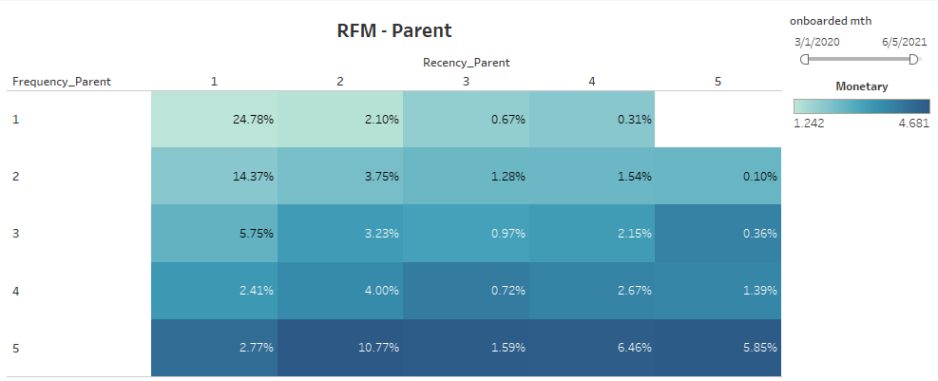
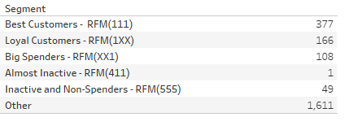
RFM
Analysis: From the RFM of heatmap (upper figure)we can see there are some segments with high R and high F with low M. Also in high R and low F and high M. Lower figure shows the segments based on the RFM.
Recommendations: direct the marketing efforts based on the segments. For examples aggressive incentives to Inactive customers.

Slide 34
Business Data analysis/商业数据分析
MARKETING/市场营销部门项目
Type of Marketing Campaigns/市场营销活动的主要种类
Product Marketing Campaign/产品营销活动
Acquisition Marketing Campaign/客户获得
Customer retention Campaign/客户挽留
Budget/预算: Not all marketing campaigns require an incremental budget, but many still do. Factor in the agency, advertising, and freelance costs, if appropriate, and factor these numbers into any ROI analysis/投资回报分析 for your campaign.

Slide 35
Business Data analysis /商业数据分析
MARKETING/市场营销部门项目
怎么算促销活动的回报？

Slide 36
Business Data analysis /商业数据分析
ROI Financial analysis
随机
非随机

Slide 37
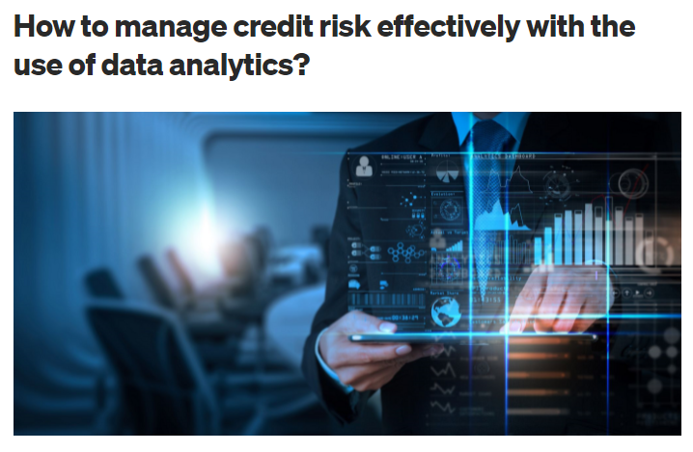
Credit Risk & Credit Losses
Business Data analysis /商业数据分析

Slide 38
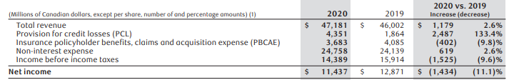
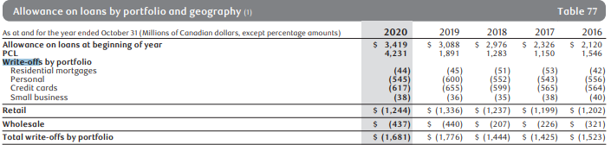
Credit Risk & Credit Losses
Business Data analysis /商业数据分析

Slide 39
Credit Risk & Credit Losses
Business Data analysis /商业数据分析
Credit risk refers to the potential for loss due to the failure of a borrower to make a payment when it is due
信贷风险是指客户还不起钱的风险
Credit losses: losses from delinquent and bad debt or other credit. 风险发生后，信贷风险变成信贷损失
Can we implement data-driven strategy to 1, Prevent Credit Losses?怎么防止信用借贷损失？ 2, Mitigate Credit Risk (and better PCL estimation)? 减轻信用借贷风险 3, Improve Portfolio Performance?怎么提高借贷组合业绩

Slide 40
Business Data analysis/商业数据分析
银行内部审计和风险控制

Slide 41

Business Data analysis/商业数据分析
Business Problem statement
风险控制对银行的成功与失败至关重要！

Slide 42
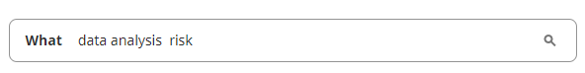
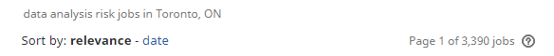
Business Data analysis/商业数据分析
工作机会

Slide 43
Business Data analysis/商业数据分析
internal audit & RISK/风险和内部审计
内部审计internal audit ，是一种独立、客观的确认和咨询活动，它通过运用系统、规范的方法，审查和评价组织的业务活动、内部控制和风险管理risk management的适当性和有效性，以促进组织完善治理、增加价值和实现目标
内部审计internal audit在商业银行风险管理risk management中的作用
客观识别和评估风险
综合分析和计量风险
风险预警

Slide 44
Business Data analysis/商业数据分析
internal audit and DATA /
风险和内部审计与数据的关系
Internal audit in the age of data analytics数据时代下的内部审计
Fast-evolving technologies that generate-increasing amounts of data have created an opportunity机会 for internal audit departments to leverage data to evaluate risk and drive audit insight. As a result, data analytics is increasingly becoming an indispensable element不可分割的元素 of the internal audit toolset.
Data Analytics Transforms Internal Auditors Into Strategic Advisors策略顾问

Slide 45
Business Data analysis/商业数据分析
internal audit and DATA /
风险和内部审计与数据的关系
Audit Analytics & Financial Fraud Risk Analysis
审计分析和金融欺诈风险分析

Slide 46
Business Data analysis/商业数据分析
internal audit and DATA /
风险和内部审计与数据的关系
Findings 1
Fraud Risk?
Findings 2
Fraud Risk?
…
Findings 10000
Fraud Risk?

Slide 47
Business Data analysis/商业数据分析
internal audit and DATA /
风险和内部审计与数据的关系
Audit Analytics & Bankruptcy Analysis
审计分析和破产分析

Slide 48
internal audit & RISK/风险和内部审计
银行破产主要风险
Internal Risks:
i.Industry risk (IR) 行业风险:
Government policies and International agreements,
Cyclicality,
Degree of competition,
The price and stability of market supply,
The size and growth of market demand,
The sensitivity to changes in macroeconomic factors,
Domestic and international competitive power,
Product Life Cycle.
ii.Management risk(MR)管理风险:
Ability and competence of management,
Stability of management,
The relationship between management/ owner,
Human resources management,
Growth process/business performance,
Short and long term business planning,
achievement and feasibility.
iii.Financial Flexibility(FF)金融灵活性:
Direct financing,
Indirect financing,
Other financing
Internal Risks:
iv.Credibility (CR)可信度（信用）:
Credit history,
reliability of information,
The relationship with financial institutes.
v.Competitiveness (CO)竞争性:
Market position,
The level of core capacities,
Differentiated strategy,
vi.Operating Risk (OP)操作风险:
The stability and diversity of procurement,
The stability of transaction,
The efficiency of production,
The prospects for demand for product and service,
Sales diversification,
Sales price and settlement condition,
Collection of A/R,
Effectiveness of sale network.

Slide 49
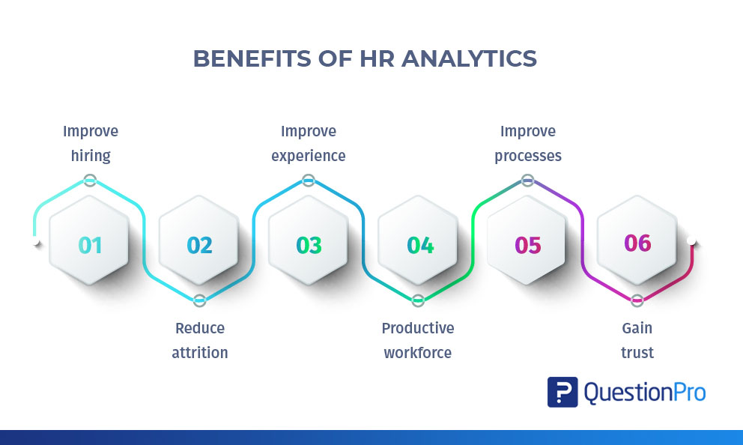
Business Data analysis /商业数据分析
HR/人事部门数据分析

Slide 50
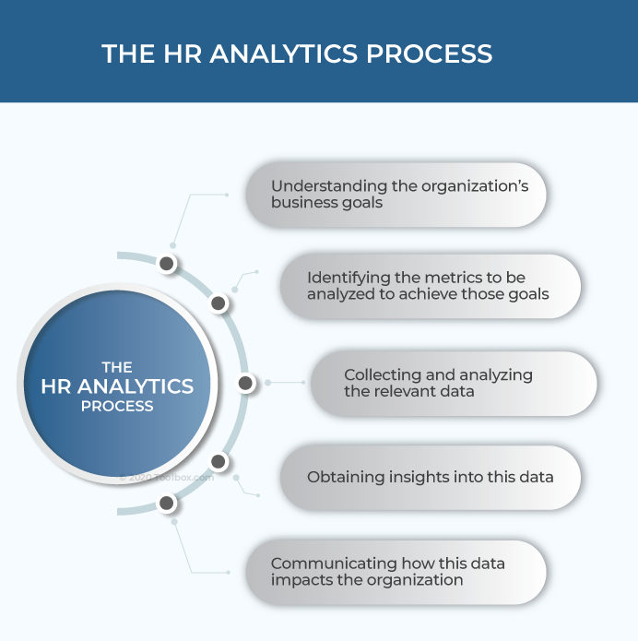
Business Data analysis /商业数据分析
HR/人事部门数据分析

Slide 51
面试英语---反客为主
Pain points- Behavioral/situational Questions

Slide 52
Behavioral/situational Questions – Framework/框架
Strength
Weakness
Conflicts
Mistakes
Deadline
Pressure
?
?

Slide 53
面试英语---反客为主
Strength or Weakness? - Teamwork
Teamwork gets job done efficiently
To build up a successful team relationship, it not only requires strong communications skills but also an established process to follow.
focusing on issues instead of people;
progress transparent to the whole team;
clear expectation when assigning works to colleague;
taking the initiative and leadership for new assignments;
providing timely support and guidance to new team members.
By keeping practicing teamwork, I’ve successfully developed and maintained constructive working relationship with my colleagues

Slide 54
面试英语---反客为主
Strength or Weakness? - Communication
Successful organization likes employees with strong communication skills.
Everyone has a room to improve on this subject.
When I first started my career I was very bad at communication
With this consideration in mind, I started and kept practicing on my communication skills in subjects like business writing, public speaking and public event facilitation.
Some tricks I have learned are pay attention to people’s interest(listen), respond quickly, thank people quickly, don’t be afraid of escalating if you can’t solve the problem.
The results are positive – it not only helps me to maintain the internal communication channel within the team, but also a good client relationship

Slide 55
面试英语---反客为主
Strength or Weakness? - Leadership
Adopting leadership, will help individual stand out as an excellent employee, professional and colleague.
initiative to act on opportunities,
go extra mile when asked to do tasks,
take ownership of problems and
provide proper training / support to new members.
The effort is rewarded –my colleagues recognize me as a trusted team member with strong leadership

Slide 56
面试英语---反客为主
Strength or Weakness? - Problem Solving
Problem Solving is the key to success in working environment;
follow the existing case if there is best practice can serve as reference in company’s previous case studies.
do my homework on the subject, collect valuable input, and form the solution based on the feedbacks.
One trick I use lot is isolating the problems. That’s a good way to solve problem in a complex process, especially data process.
if it doesn’t problem, issue will be escalated to management team in a timely manner to avoid unexpected surprises
This approach solves challenges most of time

Slide 57
面试英语---反客为主
Strength or Weakness? - Multi-tasking
Multi-tasking helps me reduce pressure and avoid missing deadlines.
It involves time management and task prioritizing skills as well.
Whenever I get assignments, particular for ad hoc item, instead of trying to form a solution in rush, I will
perform a preliminary assessment.
Once the job is qualified, I will estimate the time it will take,
check schedule to determine the possibility of accommodating the request,
Rearrange work items based on its urgency, dependency and priority
By having such strategy in place, it improves the effectiveness and efficiency of my work

Slide 58
面试英语---反客为主
Negative Behavioral Questions – Conflicts with co-workers
Conflict is a strong word
I rarely have conflicts with my co-workers
We may have technical disagreements sometimes
Solution –
Put myself into other’s shoes
Don’t get personal
and find third party experts for opinions
Find common ground
My strength is team work – I am a very good team player
I take initiatives
I go extra mile
I own problems
I help new team members
By focusing on the team’s interest and being a good team player I minimize chance of conflicts

Slide 59
面试英语---反客为主
Negative Behavioral Questions – Conflicts with Manager
Conflict is a strong word
I rarely have conflicts with my managers
We may have technical disagreements sometimes
Solution – Don’t get personal and find third party experts for opinions
My strength is team work – I am a very good team player
I take initiatives
I go extra mile
I own problems
I help new team members
By focusing on the team’s interest we never had a problem

Slide 60
面试英语---反客为主
Negative Behavioral Questions – Conflicts with Manager(story version)
Problem:
Manager wants to assign me more work
I already have tons of work and tight deadline
Analysis
I put myself into her/his shoes and understand that she also faces pressure from large workload
I use my multitasking and problem solving skills and communication skills: I took a look at the work and notice that I could break down the task into smaller tasks
Solution & Action
I could prioritize some of them. Then I communicated with client and they agreed that they could take some deliverables before the deadline and others the next week. Manager was happy that problem solved.

Slide 61
面试英语---反客为主
Negative Behavioral Questions – Mistakes（story）
Everyone makes mistakes
What is more important is how we apply the knowledge from previous mistakes to the future cases to prevent similar mistakes from happening again.
[Name a less server case here Must be work related Need to be eliminated before causing any damage] – there was this case where the client found out that there was a calculation error in a dashboard after we published it. Fortunately it was a small mistake and it got fixed in a few minutes.
I used my problem solving skills
I did a thorough investigation
and found the root cause by isolating the problems
and documented it carefully to reduce the chance for it to happen again
In addition to simply correcting the mistake, I started to develop a checking list for purpose of process continuous improvement.
By having this precaution measure in place, I didn’t commit the same mistakes in my work ever after.
Strength – learning skills: learning from mistakes

Slide 62
面试英语---反客为主
Negative Behavioral Questions – Mistakes 2
Question: what was your biggest mistake?
Other version: if you can go back in time, what would you change?
Answer: Same as weakness
When I started my career I didn’t care about team work
I think I am the best I can do stuff by myself I don’t care what others think
That altitude got me into lots of troubles: missing deadlines constantly because nobody wanted to help me
That was my biggest mistake
I started learning to become a good team player

Slide 63
面试英语---反客为主
Negative Behavioral Questions – Deadline
The work of acting data analyst is time sensitive. To avoid missing deadline:
careful planning,
performed risk analysis in advance,
and assigned tasks accordingly.
progress transparent to avoid unexpected issue from happening.(daily standup meetings)
Escalate should there be critical issues jeopardizing the deadline
If deadline tight, break down and prioritize deliverables to satisfy clients

Slide 64
面试英语---反客为主
Negative Behavioral Questions – Pressure
Work in fast paced environment with high volume of workload could be stressful
well planning, time management and multitasking skills.
Once assigned with multiple projects,
I will get as much information as possible
breakdown an assignment into smaller pieces to minimize the work-in-progress;
label breakdowns with different color codes by level of severity;
reshuffle working items based on priority and scheduling;
keep accurate records and maintain a To-Do lists as the complexity of the project grows
With above approach, I’m able to do multitasking to reduce my pressure from work

Slide 65
面试英语---反客为主
Behavioral Questions – next 5 year future goals
I like do things with a plan (strength)
If I was hired by your company
Short term goal would be get myself familiar with the business, project develop process and data process.
Long term goal would be applying my experience and skills to identify opportunities and execute data solutions to add value to business and become a go-to person in the team with leadership.
I like to develop a long term relationship with a company

Slide 66
面试英语---反客为主
Behavioral/situational questions:
Under tight deadline but can’t deliver project on time, what would you do?
Why do you apply this role?
What can you bring to the company?
Why leave current company?
You have been fixing a project/data process for a long time, how do you decide when it’s time to start building a new one or continue what you have been doing?
Tell me one time you led a team to achieve a common goal?
What’s the toughest decision you had to make in the last few years?
Tell me one time you felt company leadership was wrong and what did you do?
you present something but the audience disagree, how do you convince her/him or deal with the situation ?
How do you balance work and learning?
What you don’t like about your last job?
How do you react when you are angry?
What are 3 positive things you boss or co-worker would say about you?
What kind of person you don’t want to work with?
What has been your biggest professional disappointment?
Do you think you are overqualified for this position?
How do you deal with big volume of data?
What do you know about our business?

Slide 67
简历面试
怎么写针对数据工作的简历
KEY WORDS AND PROCESS/关键词和过程
怎么应对时间工作面试的问题
Take control of the interview/怎么控制面试
Don’t let hiring managers control the interview/怎么不让面试官控制面试

Slide 68
课程简介
适合零基础或者有基础的同对数据分析感兴趣的同学
工具基础课 --- 学习常用工具已经如何使用这些工具
Python --- 基本语法，常用 Python Modules, Packages, Libraries
SQL --- 基本语法，常用QUERIES,STATEMENTS
POWER BI --- 常用设计，收集，准备，MODEL，分析，视觉化
TABLEAU ---常用设计，收集，准备，分析，视觉化
项目内容---用Python, SQL,POWER BI, TABLEAU 来做项目
数据架构1个项目
怎么搭建数据架构
Sales 销售3个项目
销售业绩，
客户关系管理，
促销活动
Marketing 营销1个项目
客户流失分析
Internal Audit/Risk 风控3个项目
破产风险分析，
欺诈分析，
异常分析
Credit 信用1个项目
信用分析
HR 人事1个项目
雇员流失分析
简历面试
怎么写针对数据工作的简历
KEY WORDS AND PROCESS/关键词和过程
怎么应对工作面试的问题
Take control of the interview/怎么控制面试
Don’t let hiring managers control the interview/怎么不让面试官控制面试

Slide 69
工具基础课---简历面试常用 SQL
SELECT Statement Practice
where Statement Practice
JOIN Statement Practice
INNER JOIN Statement Practice
RIGHT & LEFT JOIN Statement Practice
union Statement Practice
Union vs union all Statement Practice
intercept vs except Statement Practice
aggregation Statement Practice
SORT Statement Practice
Group by Statement Practice
Having Statement Practice
String Statement Practice
Date Statement Practice
null Statement Practice
cast Statement Practice
derived Statement Practice
with Statement Practice
case Statement Practice
Create, insert, update, delete Statement Practice

Slide 70
工具基础课---简历面试常用 Python
Python Modules,
Packages, Libraries
Object creation
Viewing data
Selection
Missing data
Operations
Merge
Grouping
Reshaping
Time series
Categoricals
Plotting
Getting data in/out
Error handling

Slide 71
工具基础课---简历面试常用 POWER BI
Get data
Prepare your data
Model your data
Write a measure in DAX
Build your report
Format the report
Finished report
Save your report

Slide 72
工具基础课---简历面试常用 TABLEAU
1: Connect to and Transform Data
1.1. Connect to data sources
1.2. Prepare data for analysis
1.3. Customize fields
2: Explore and Analyze Data
2.1. Create calculated fields
2.2. Create quick table calculations
2.3. Create custom table calculations
2.4. Create and use filters
2.5. Create parameters to enable interactivity
2.6. Structure the data
2.7. Map data geographically
2.8. Summarize, model, and customize data by using the Analytics feature
3: Create Content
3.1. Create charts
3.2. Create dashboards and stories
3.3. Add interactivity to dashboards
3.4. Format dashboards
4: Publish and Manage Content on Tableau Server and Tableau Online
4.1. Publish Content
4.2. Schedule data updates
4.3. Manage Published workbooks

Slide 73
课程目的：拿OFFER
简历
学习
简历
面试

Slide 74
简历
Prepare a resume first even the only thing on it is your name
Smith 123 street Toronto, ON smith@gmail.com
Objective: Data Analyst
Qualifications
1
2
3
Career Experience
1
2
3
Education

Slide 75
简历模板/内容
Business process/业务流程
Identify/understand business goals/problems/opportunities
Review documents and interview SME(Subject Matter Expert)
Convert business problems to metrics. Discuss metrics with stakeholders
Propose data solutions to the problems/opportunities identified
Identify & meet with stakeholders
Set & prioritize goals
Collect business requirements
Define deliverables
Create project schedule
Identify risk /potential roadblocks
Data collection
Data preparation
Data Analysis
Data visualization/reporting
Data productization
Testing
Present solution/story telling
Project process/项目流程
Data process/数据流程

